Slide 1

Presented By:- Presented To:- Ayush Kaushal(201500178) Mr. Bhanu Kapoor Mrigank Gahoi(201500415) (Technical Trainer) Dhruv Gupta(201500221)
MINI PROJECT 2
On
FOOD DELIVERY APP

Slide 2
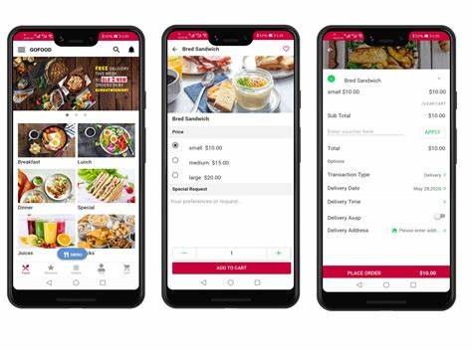
What IS FOOD DELIVERY APP?
A food delivery app mainly solves the following problem of a customer: It provides all the best restaurants to order food which are nearby to customer. It takes the shortest time possible to deliver the food. It asks you about your experience or feedback about the delivery boy and the restaurant.

Slide 3
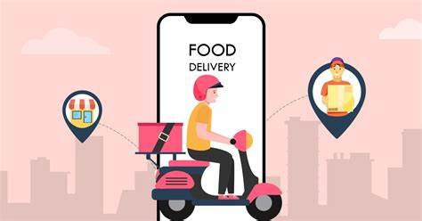
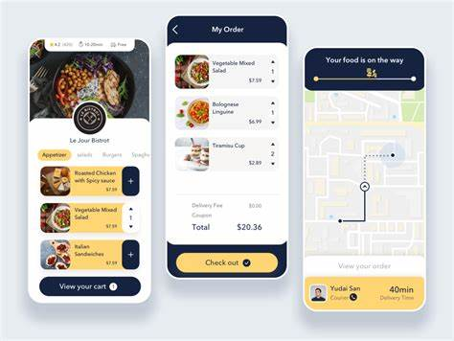
INTRODUCTION
Online food ordering is the process of ordering food, for delivery or pickup, from a website or other application. The product can be either ready-to-eat food (e.g., direct from a home-kitchen, restaurant, or a virtual restaurant) or food that has not been specially prepared for direct consumption (e.g., vegetables direct from a farm/garden, fruits, frozen meats. etc.)

Slide 4
PURPOSE
Customers may track the location of their food using real-time GPS, which is one of the essential features of food delivery apps.
The goal of GPS is to provide two-way tracking and operation.
An order is typically made either through a restaurant or grocer's website or mobile app, or through a food ordering company.

Slide 5
Existing Features
“ FOOD DELIVERY APP’’ has been designed to computerize the following functions that are performed by the system :
Delivering Choices of the Food according to User Demands.
Check-in and check-out Functions.
Statement of Customer Details.
Food Interest Details.

Slide 6
Software Requirements
System Development software:-
Operating system : Windows
VS Code
React
MongoDB
User required software:-
Operating System : Windows 7,8,10
GitHub

Slide 7
HARDWARE REQUIREMENTS
System Development hardware:-
CPU : AMD Ryzen 5 , 4.0GHz
RAM : 8GB
Monitor : Color monitor

Slide 8
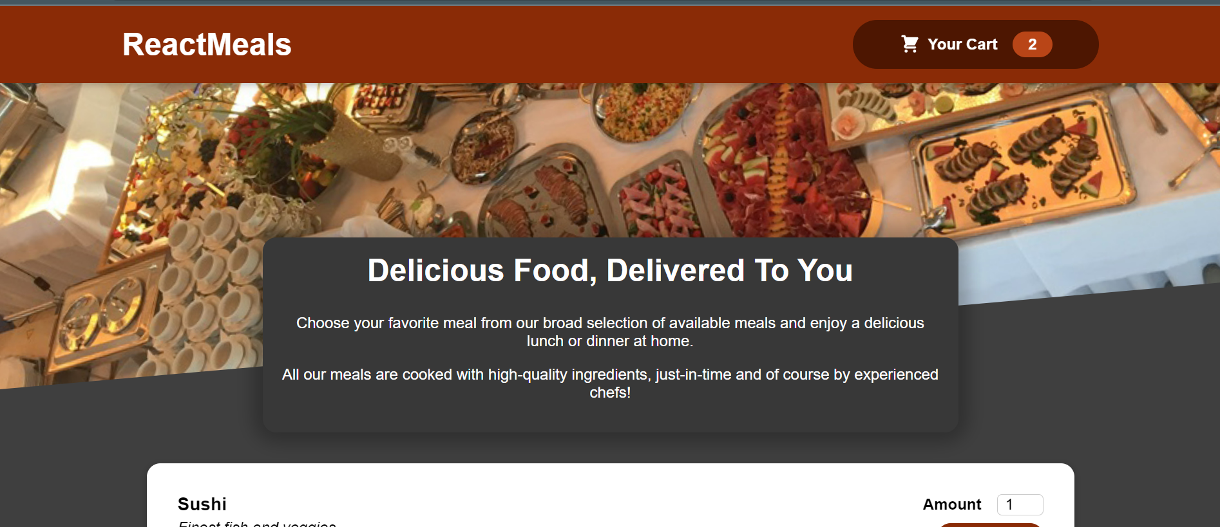
FRONTEND of FOOD DELIVERY APP

Slide 9
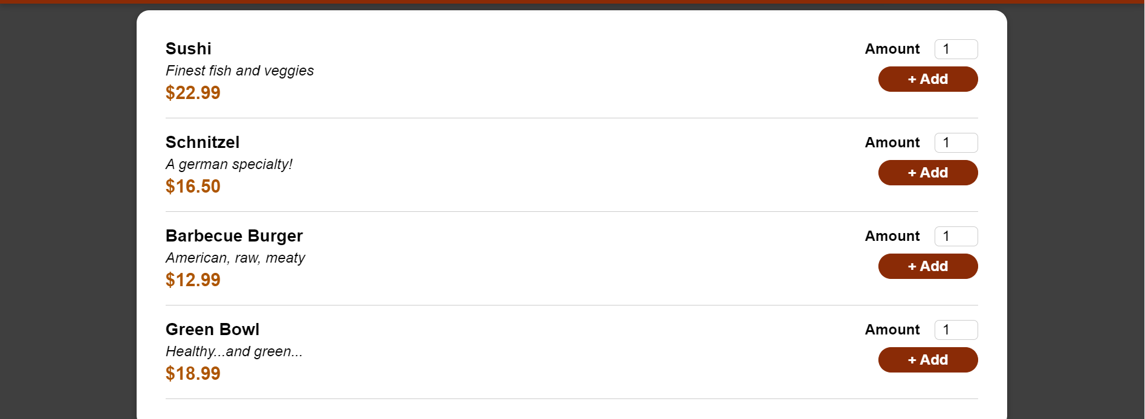
FOOTER page

Slide 10
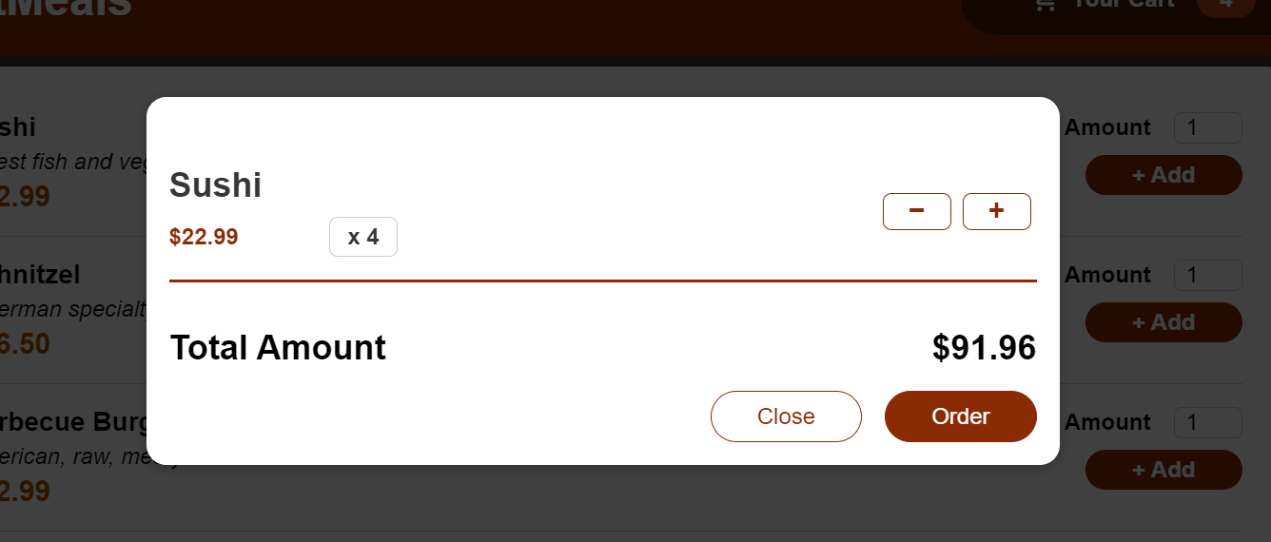
PRODUCTs

Slide 11
IF the user searched the FOOD of his interest:

Slide 12
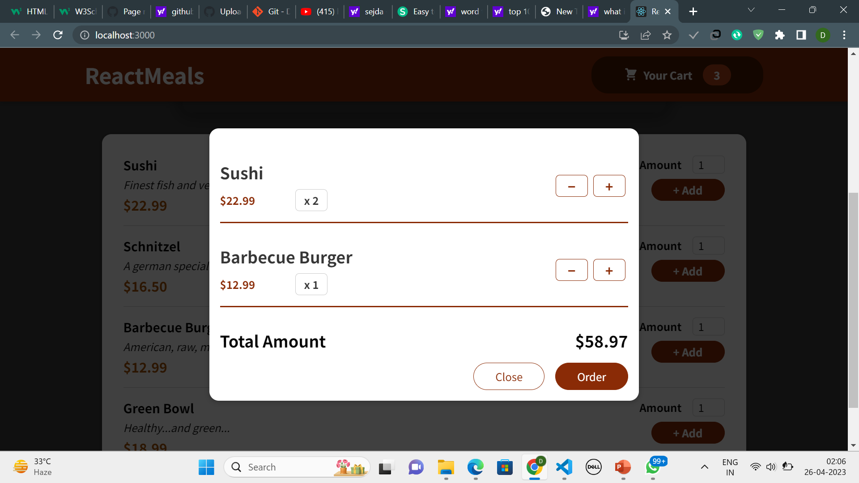

the user CAN ALSO ADD THE QUANTITIES TO THE CART:

Slide 13
Thank you !!

